Slide 1



Online Safety
Year 7 Health – 2024
Lesson 1

Slide 2

today's Focus:
Consider all the different online platforms.
List reasons why people go online.
Identify potential consequences of being online and reasons why age restrictions exist.

Slide 3
The internet can be a wonderful tool for you to learn, communicate with others and play games, but this isn’t without risks. Children are accessing technology and the internet at a younger age than ever before. It’s never too early to start chatting about how to stay safe online. The key message is that if you ever see anything that makes you feel unsafe, worried or scared, then you should report to someone you trust.

Slide 4
HOOK: POST IT SLAM
Everyone will receive a sticky note.
Write your name on your sticky note and complete the sentence below.
Once answered, place your sticky note on the whiteboard.
“To me, online safety means…”
Notes:
Resources required – post it notes.
Teacher choice as to whether students need to write their name on the sticky note.

Slide 5

GLOSSARY: (Pg. 5)
At the front of your books is your glossary. Turn to your glossary and add the following words and their definitions:
Cyber Safety:
The safe and responsible use of information and communication technologies (ICT).
E.g., safe use of the internet, social media, online games, smart phones, tablets and other connected devices.
Notes:
Cyber safety definition:
Cyber Safety Guide for Schools (brainstormproductions.edu.au)

Slide 6
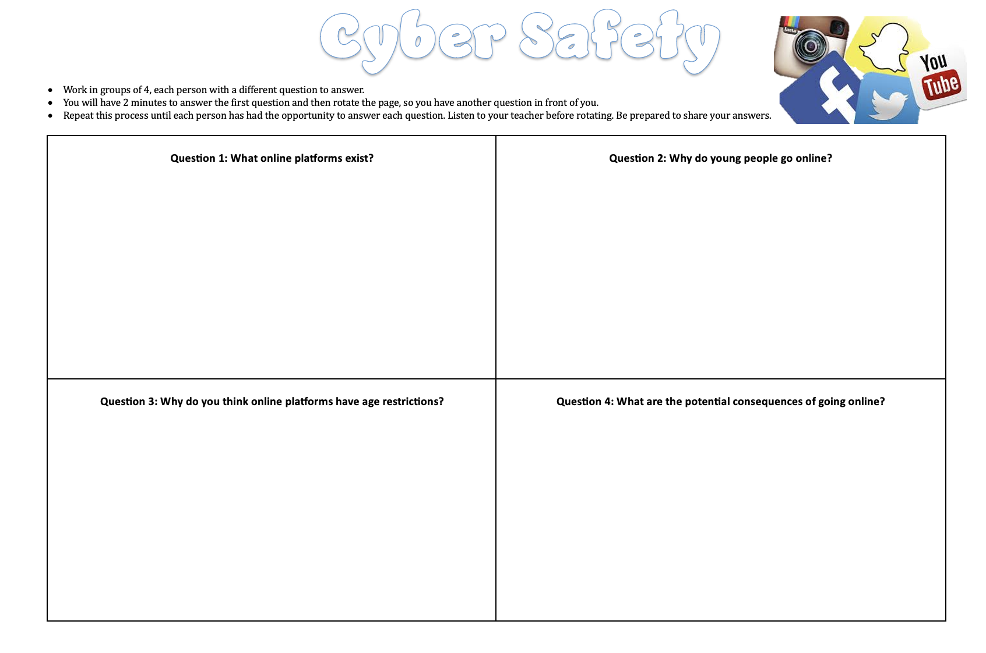
Activity 1: (Pg. 7) Cyber Safety Placemat
Students are in groups of 4, each group with an A3 placemat worksheet.
Each box has a different question.
Time will be allocated to answer each question.
After the time limit, rotate the paper so you are faced with a new question.
Repeat until all students have answered all questions.
Be prepared to share your answers.
At the end of the activity, add 5 answers to each question into the space on pg. 7 of your workbooks.
Notes:
ALTERNATIVE ACTIVITY – Instead of doing a placemat, discuss each question with students over the next few slides and get them to write answers into their books.
Resources: placemat activity w/s
Instructions:
- Students are to work in groups of 4. Each group gets a placemat worksheet.
- Students allocate each other to a question and spend 2 minutes answering the first. After two minutes, rotate the paper so each student has a different question in front of them.
- Students then have a further 1 min 30 to answer their second question. Rotate so each student has a different question in front of them.
- Students have a further 1 min 30 to answer their third question. Do one final rotation so each student has the fourth and last question in front of them.
- Students have a final 1 minute to add any answers to the last question.
- Have a class discussion about answers. Students must answer the questions in their books and write at least 5 answers to each question.
**As more students write more answers to the questions, shorten the time limits.
**Adjust as necessary for your class.

Slide 7



Activity 1: What online PLATFORMS exist? (Pg. 7)
Facebook
YouTube
WhatsApp
Messenger
Google
WeChat
Instagram
QQ
Tumblr
Linkedln
Viber
Snapchat
Pinterest
Qzone
Tik Tok
X (Twitter)
Reddit
Notes:
If completing the placemat: Discuss answers after and instruct students to write down at least 5 answers into their workbooks.
If not completing the placemat: Brainstorm and a class and students write answers into their books.
Option 1: Allow students to come to the board and write their answers.
Option 2: Students say their answers and teacher to write their answers on the board.
Option 3: Class discussion.
FYI:
QQ = Tencent QQ, also known as QQ, is an instant messaging software service and web portal developed by the Chinese technology company Tencent. QQ offers services that provide online social games, music, shopping, microblogging, movies, and group and voice chat software
Qzone = Qzone is a social networking website based in China which was created by Tencent in 2005. It allows users to write blogs, keep diaries, send photos, listen to music, and watch videos.
WeChat = WeChat or Weixin in Chinese is a Chinese instant messaging, social media, and mobile payment app developed by Tencent. First released in 2011, it became the world's largest standalone mobile app in 2018 with over 1 billion monthly active users.

Slide 8
Activity 1: Why do we go online? (Pg. 7)
Socialising
Connect with friends and family
Research/homework
Shopping
Gaming
Streaming TV and movies
Listening to music
Watching videos
Notes:
If completing the placemat: Discuss answers after and instruct students to write down at least 5 answers into their workbooks.
If not completing the placemat: Brainstorm and a class and students write answers into their books.
Option 1: Allow students to come to the board and write their answers.
Option 2: Students say their answers and teacher to write their answers on the board.
Option 3: Class discussion.

Slide 9

Activity 1: (Pg. 7) Why do some ONLINE platforms have age restrictions?
Personal information
Cyberbullying
Predators
Safety of children
Maturity
No control
Not educated enough
Ethical thinking/unable to think of the consequences
Q: Do you know the age restrictions for the different online platforms?
Facebook
Instagram
Snapchat
X / Twitter
YouTube
Google Accounts
WhatsApp
Notes:
If completing the placemat: Discuss answers after and instruct students to write down at least 5 answers into their workbooks.
If not completing the placemat: Pair and Share and students write answers into their books.
- With your partner, discuss why you think some online platforms have age restrictions.
- Write your answers in your books.
- Be prepared to share with the class.
- You have 3 minutes.
Option 1: Pair and share as above.
Option 2: Allow students to come to the board and write their answers.
Option 3: Students say their answers and teacher to write their answers on the board.
Option 4: Class discussion and can ask students for a show of hands who has each of the online platforms.

Slide 10
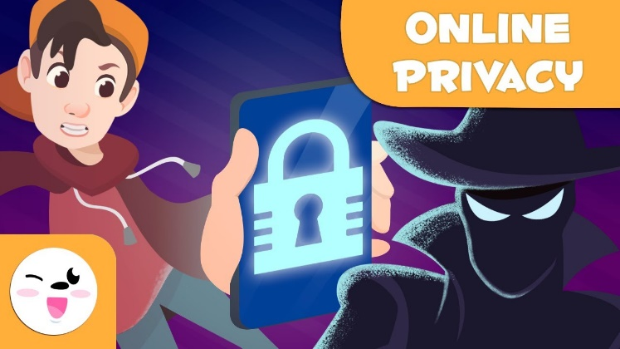
Activity 1 Consequences of being online? (Pg. 7)
Being exposed to inappropriate or upsetting content like mean, aggressive, violent or sexual comments or images.
Uploading inappropriate content like embarrassing or provocative photos or videos of themselves or others.
Sharing personal information with strangers – i.e., phone numbers, date of birth or location.
Cyberbullying.
Exposure to too much targeted advertising and marketing.
Data breaches, like having personal data sold on to other organisations.
Potential exposure to unwanted contact and online grooming.
Potential exposure to explicit content (i.e., online pornography).
Spend a lot of time online/addiction.
Online gambling.
REFLECTION: 2 minutes
List all the online platforms you use and accounts you have.
Notes:
If completing the placemat: Discuss answers after and instruct students to write down at least 5 answers into their workbooks.
If not completing the placemat: Students simply write answers into their books.
Option 1: Allow students to come to the board and write their answers.
Option 2: Students say their answers and teacher to write their answers on the board.
Option 3: Class discussion.

Slide 11
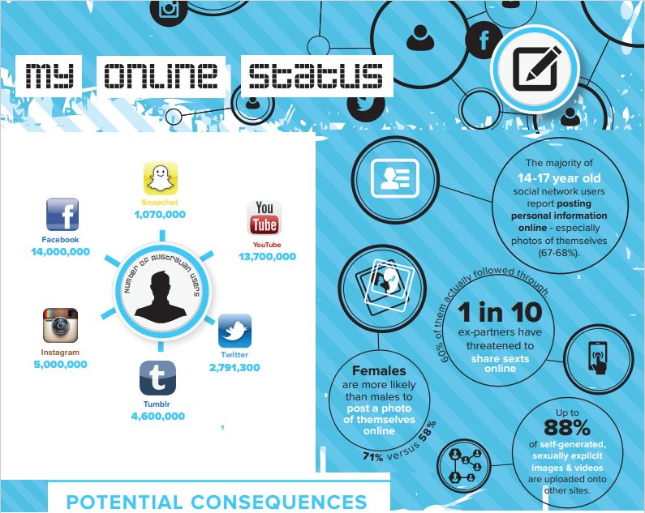
Notes:
Discuss the statistics on this slide – image also in their books.
Left image - # of Australian users on each platform
Right image – statistics on online abuse

Slide 12
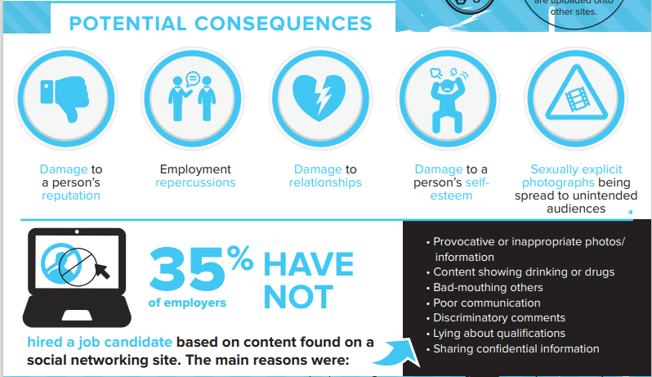
Notes:
Discuss the statistics on this slide – image also in their books.

Slide 13
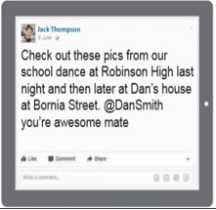

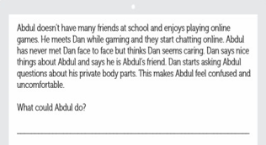
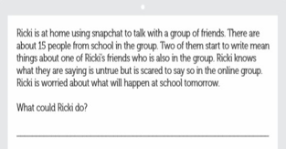
Activity 2: Keeping Safe internet basics (Pg. 9-10)
Watch the video on the next slide.
Review the online posts and scenarios and consider what could be done to make the scenario safer for the individuals involved.
Review and rewrite the social media posts to make them safer for the sender, or those who the post is about. (pg.9)
Read the online scenarios and write down what each character could do in their situation to maintain the safety and wellbeing of anyone involved. (pg.10)
You have 7 minutes. Be prepared to discuss your answers with the class.

Slide 14
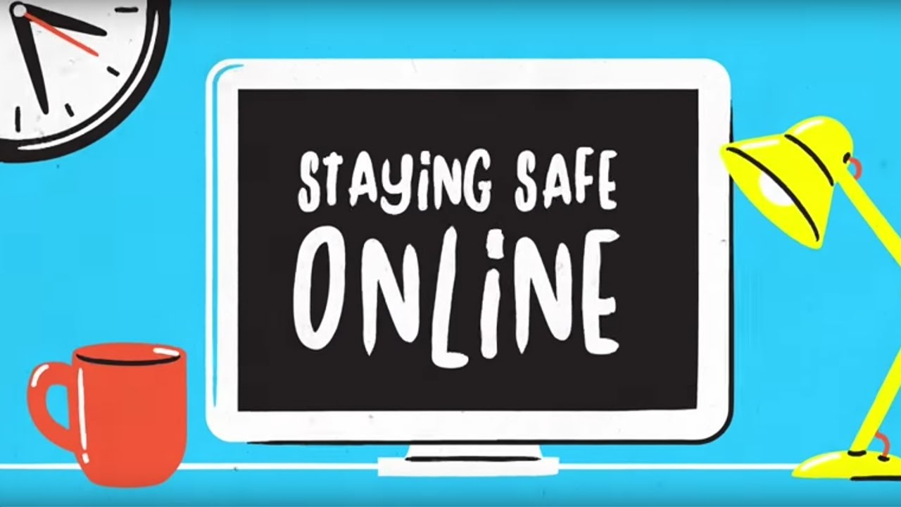

Notes:
Watch the video and answer the questions on the following slides.
https://www.youtube.com/watch?v=r3twJMzKWR8

Slide 15

Activity 3: My online status
SPIT FIRE!!
What are the different types of relationships we may have?
Family
Casual
Romantic
Friends
What healthy/positive characteristics do we expect from each of these relationships?
Trust
Honesty
Respect
Communication
Care
Notes:
SPIT FIRE = Quickly yell out the answers to the question.

Slide 16
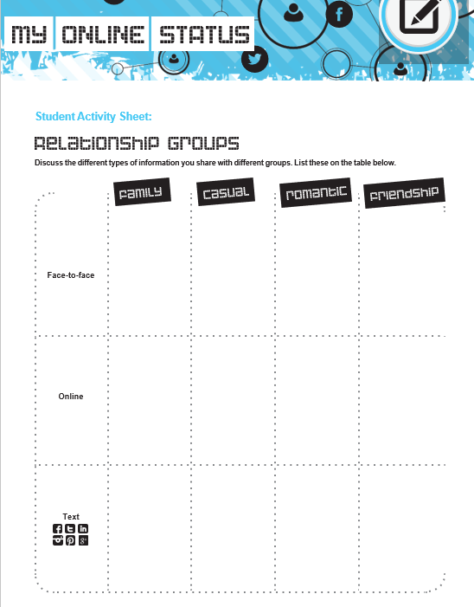
Activity 3: My online status (Pg. 11)
Now think about how these relationships may look online.
Consider the following:
What information you would share with someone who you share each type of relationship with?
Would the way the information is shared (i.e., online vs. face to face) impact what information you choose to share?
Complete the worksheet on pg.11
You have 7 minutes. Be prepared to share.
Notes:
Worksheet instructions:
- first discuss examples of the types of people in each type of relationship.
(example on next slide)
For each type of relationship, students write down examples of the sort of information they would share with each relationship and through each avenue.
E.g., face to face with family they may share more private, intimate details of their life but online with a casual friend they may not share so much.

Slide 17
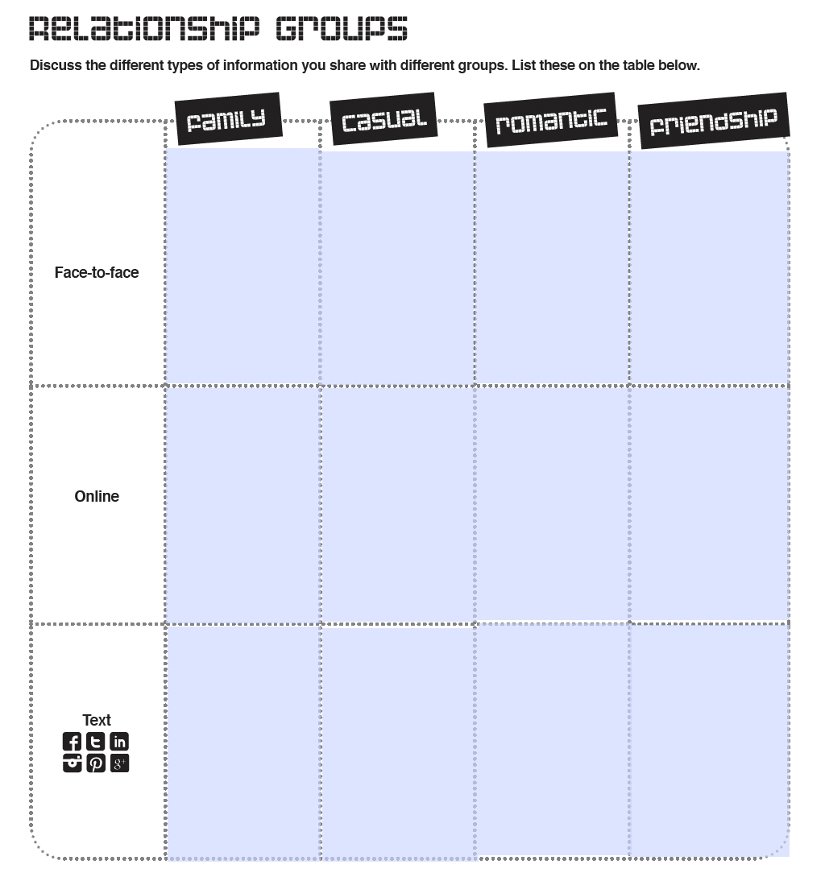
For example:
When face to face with your FAMILY, what information would you share with them?
When speaking with someone you have a CASUAL relationship with online, what information would you share with them?
When texting someone you’re ROMANTICALLY connected to through any platform, what information would you share with them?
Information about my day.
Any issues you might be having
Video’s on YouTube you might be interested in.
Times to meet up.
Weekend plans
Notes:
Answers on next slide.

Slide 18
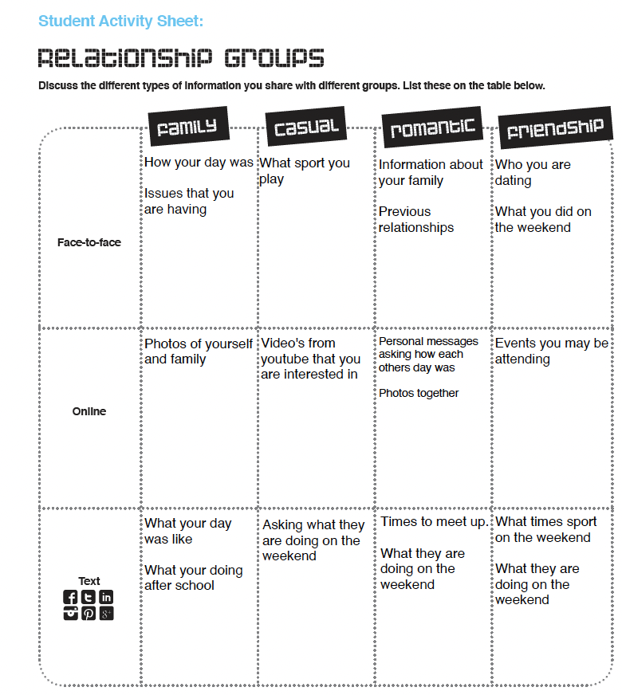
For example:
When face to face with your FAMILY, what information would you share with them?
When speaking with someone you have a CASUAL relationship with online, what information would you share with them?
When texting someone you’re ROMANTICALLY connected to through any platform, what information would you share with them?
Notes:
Answers

Slide 19

Optional Activity: Cyber Smart Kids Webinar (Pg. 12-13)
Watch the webinar on the following slide.
While watching, answer the questions on pg.12-13.
The video will be paused to give you an opportunity to fill in your answers.
Notes:
Optional activity – good for a relief lesson if needed, accompanied by other activities from this P.P.
Pause the video when each question is discussed to give students the opportunity to write their answers down.
21:05 minutes
https://www.youtube.com/watch?v=WXG5gv1ukWI&t=2s

Slide 20

Notes:
Optional activity
21:05 minutes
https://www.youtube.com/watch?v=WXG5gv1ukWI&t=2s

Slide 21

EXIT TICKET:
Have a quick chat with your friend about the statement below:
“3 things I can do to stay safe online are…”
Share your 3 things with your teacher as you leave the class.

Slide 22
Online Safety
Year 7 Health – 2024
Lesson 2

Slide 23
today's Focus:
List the potential consequences of posting images online.
Define Cyberbullying.
Investigate help seeking resources.
Reflect on your own online safety practices.

Slide 24

(Pg. 14)
In the first 5 minutes of each lesson, you will complete your revision page, you will find these throughout your booklet.
The revision page consists of three questions. It will need to be completed in detail. One-word answers will not be accepted.
The three questions :
What two concepts or ideas did I learn in class last week?
What did I find interesting about last week’s lesson? Provide a specific example.
Any questions or new words you have learnt?
The teacher will go over this each lesson with you to see what you have learnt. It is a great way for you to revisit content and test your memory.

Slide 25

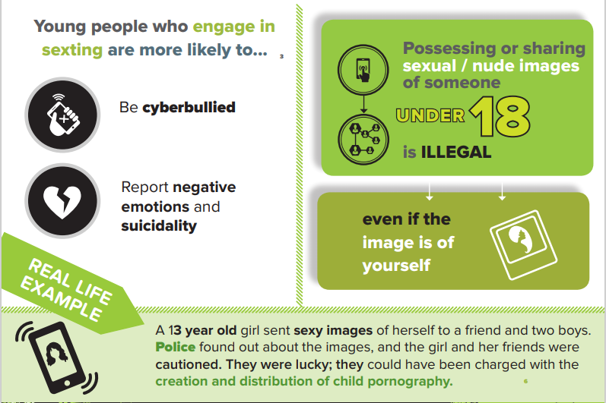
Notes:
Discuss statistics on slide.

Slide 26

HOOK: Give one, Get one Consequences of posting images online
Each student will receive a sticky note.
You will have 2 minutes to answer the question:
What are some possible consequences of sending images online?
You will then have another 2 minutes to walk around the room and GIVE ONE answer to a classmate and GET ONE answer back in return.
Create a list as big as you can.
Be prepared to share your answers.
Notes:
Resources: sticky note or scrap paper. Students could also write their list in their books.

Slide 27
HOOK: Consequences of posting images ONLINE (Pg. 15)
You lose control over your images
You can’t take a photo back from the internet
Digital kidnapping
Online bullying (Cyberbullying)
Online predators
Posting an inappropriate photo can damage a reputation and cause problems years later
Screen shots can be taken
Open yourself up to negative comments
Images shared can end up in the wrong hands
Write this list into your workbooks on pg._____

Slide 28

It is okay to share images, but it is important to think about the possible consequences that could occur and consider if it is worth it.
And this goes for sharing any kind of information.

Slide 29
GLOSSARY: (Pg. 5)
At the front of your books is your glossary. Turn to your glossary and add the following words and their definitions:
Cyber Bullying:
Cyberbullying is bullying that takes place over digital devices like mobile phones, computers, and tablets.
Notes:
Cyber safety definition:
Cyber Safety Guide for Schools (brainstormproductions.edu.au)

Slide 30
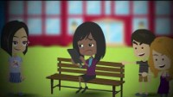
ACTIVITY 1: Is it cyberbullying?
In 2021, 44% of Australian young people reported having a negative online experience in a 6-month timeframe, this includes 15% who received threats or abuse online.
Self-reflection:
While watching the video, think about if there has been a time where you have seen cyberbullying occur.
What happened and what was the outcome?
Notes:
OPTIONAL ACTIVITY
Is it Cyberbullying? – YouTube
https://www.youtube.com/watch?v=vtfMzmkYp9E&t=169s
Cyberbullying | eSafety Commissioner
Self-reflection – students may share their experiences if they choose. Up to the teacher's discretion.

Slide 31
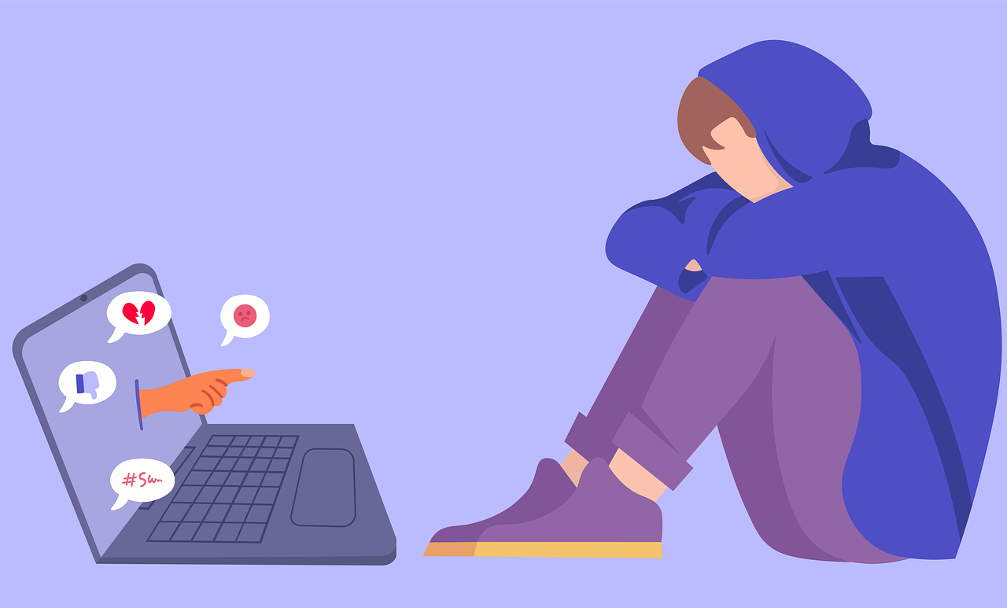
Cyberbullying (Pg. 16)
Cyberbullying is bullying that takes place over digital devices like mobile phones, computers, and tablets.
Cyberbullying can occur through SMS, Text, and apps, or online in social media, forums, or gaming where people can view, participate in, or share content.
Cyberbullying includes sending, posting, or sharing negative, harmful, false, or mean content about someone else.
It can include sharing personal or private information about someone else, causing embarrassment or humiliation.
Some cyberbullying crosses the line into unlawful or criminal behaviour.
Notes:
Fill in the blanks

Slide 32
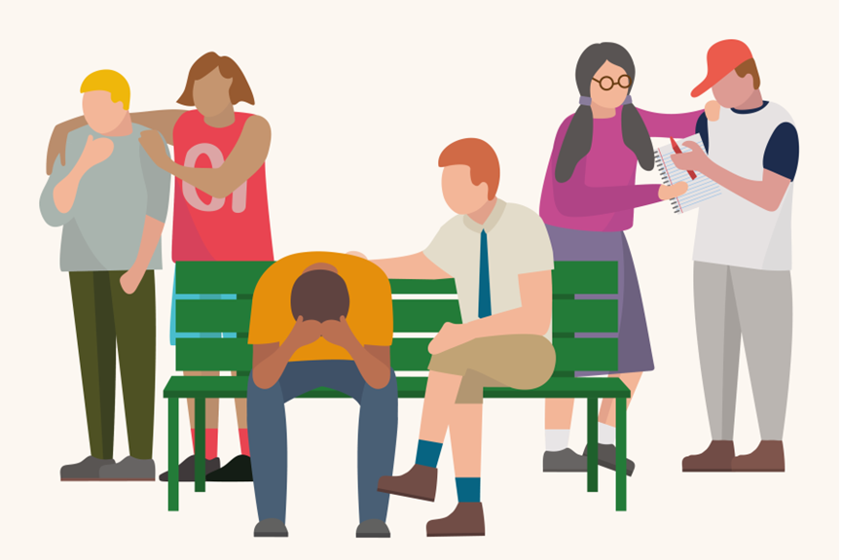
How to talk about it (PG.16)
Often young people ask their friends for help or sometimes they might notice a friend is not behaving in the same way they normally do.
What actions can you take to support your friends if they need help with something occurring online?
Don’t judge them or their issues
Listen and don’t panic
Be there for them
Talk to a trusted adult
Help them feel better (through things that enjoy doing)
Know that it gets better
Get advice online or through a health worker

Slide 33
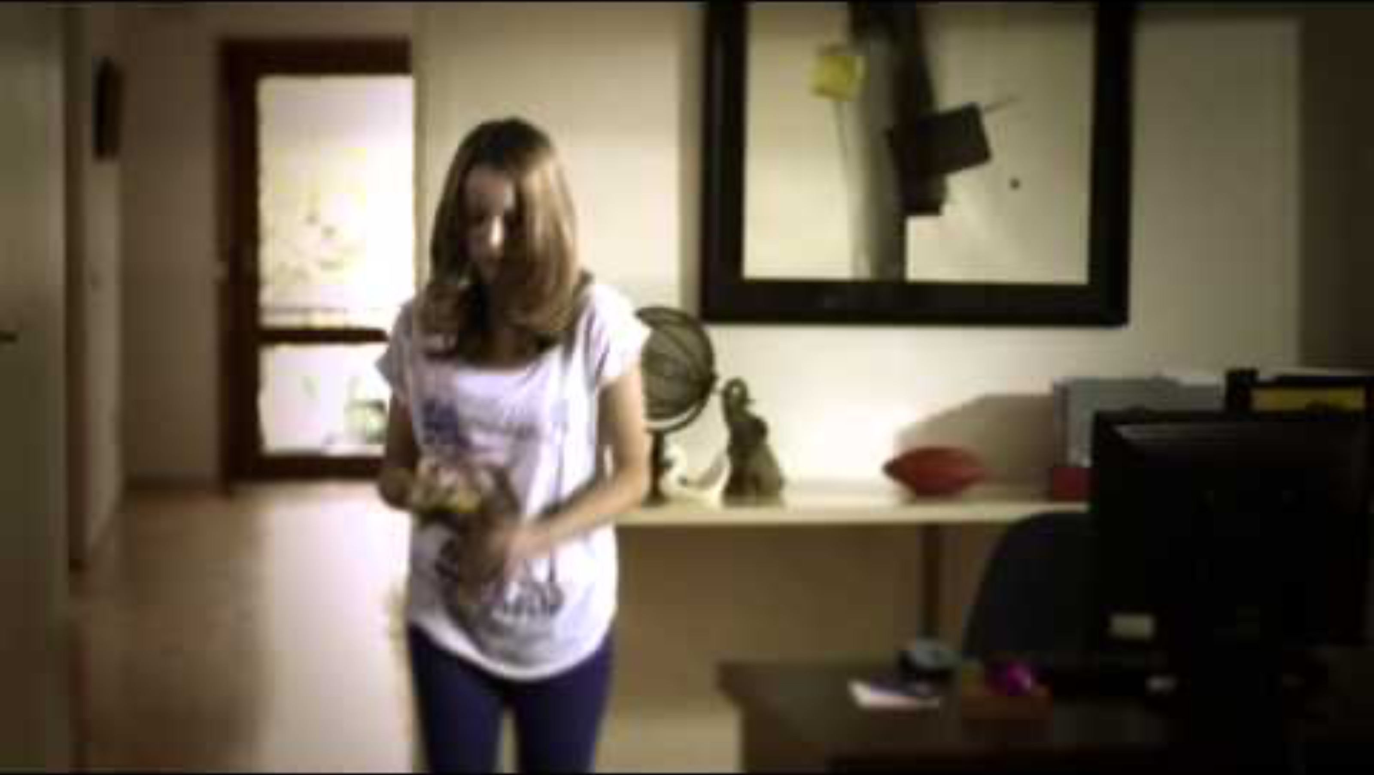
Notes:
Optional video
Cyber Slap – 59 seconds.
https://www.youtube.com/watch?v=xTLBQBYX2MQ

Slide 34




Activity 2: Where to access help – Online & OFFLINE (Pg. 17-18)
Sometimes bullying and other negative online experiences can impact a person’s mental health in a big way. Sometimes we may need a little bit of extra professional help to deal with things that are happening or the way that we are feeling.
Watch the video on the next slide before completing the next activities.
Complete the following:
Support Agencies – Offline (pg.17)
Search your local area and record the services you find by using the following website: http://www.beyondblue.org.au/getsupport/find-a-professional
Support Agencies – Online.
Visit the websites listed at the top of pg.18.
Record what information and support each site offers.
Notes:
20 minutes to complete the activity

Slide 35

Notes:
4mins
https://www.youtube.com/watch?v=24Jtowxh-ZY&t=1s

Slide 36
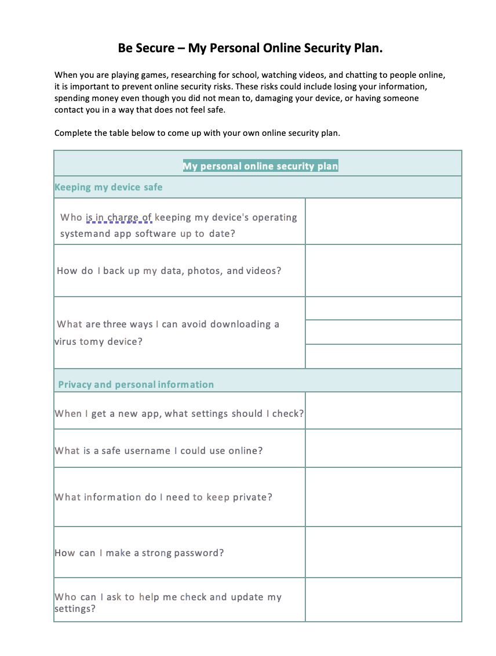
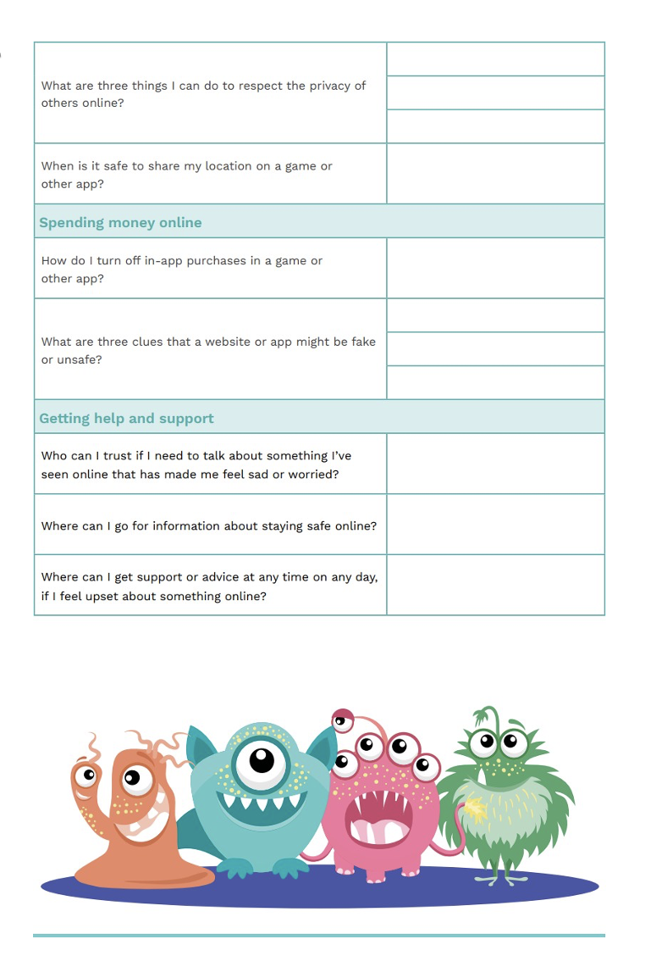
Reflection: My Security safety plan (Pg. 21-22)
Complete the ‘Be Secure Personal Safety Plan” reflection.
Notes:
Additional Activity / Optional Homework

Slide 37

Online Safety
https://create.kahoot.it/share/duplicate-of-online-safety/9e905853-eb3c-42f7-869d-ee369869f789
Notes:
ADDITIONAL / OPTIONAL
https://create.kahoot.it/share/duplicate-of-online-safety/9e905853-eb3c-42f7-869d-ee369869f789

Slide 38

Activity 4: ACT E-safe (Pg. 20)
Q1 - Explain how she uses the ‘idea of her house’ to keep safe online?
Q2 - What strategies does she put in place to be safe online?
Q3 - What suggestions does she provide to look after her ‘house’? (3 key components)
Notes:
ADDITIONAL / OPTIONAL
5mins
Original video – play from here https://www.esafety.gov.au/media/act-esafe

Slide 39
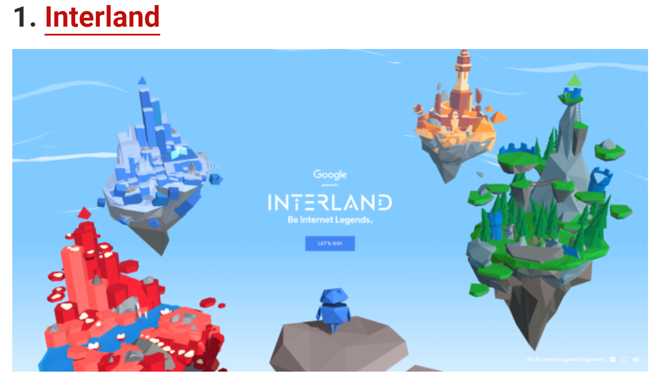
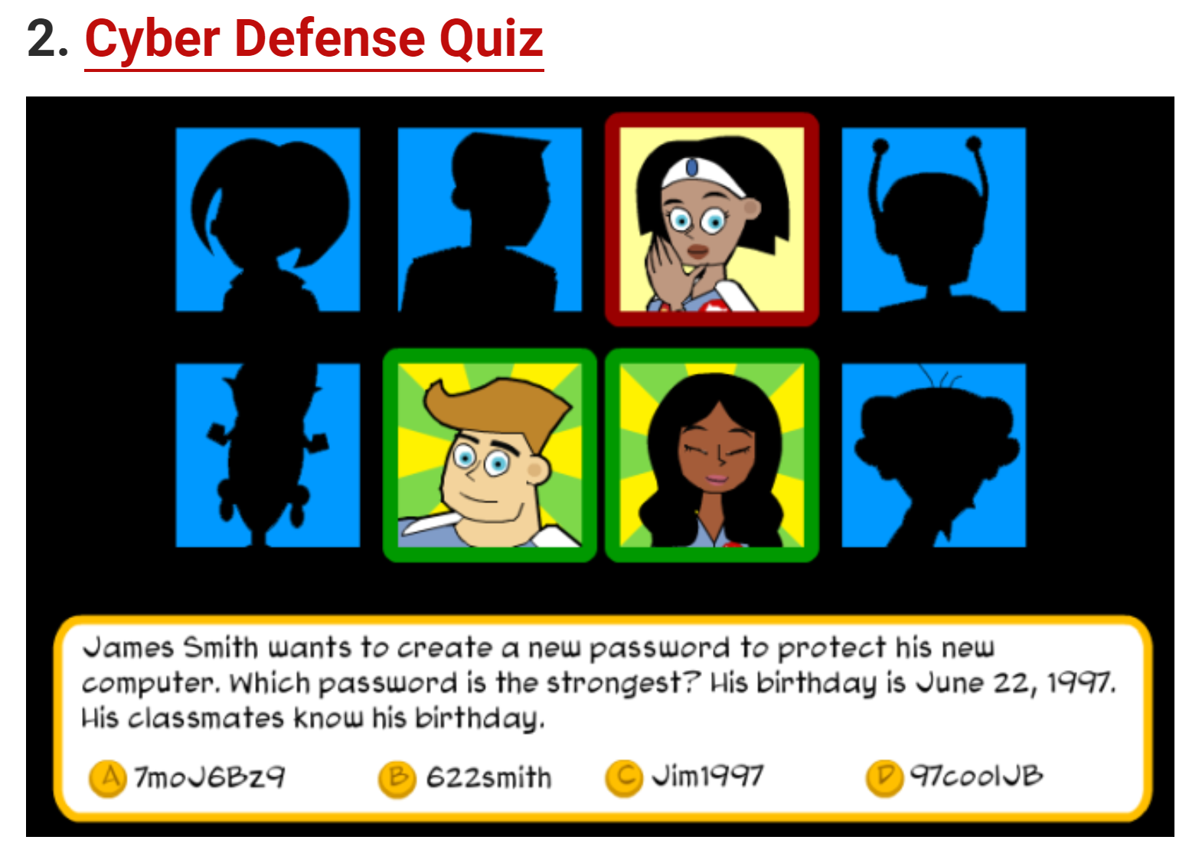
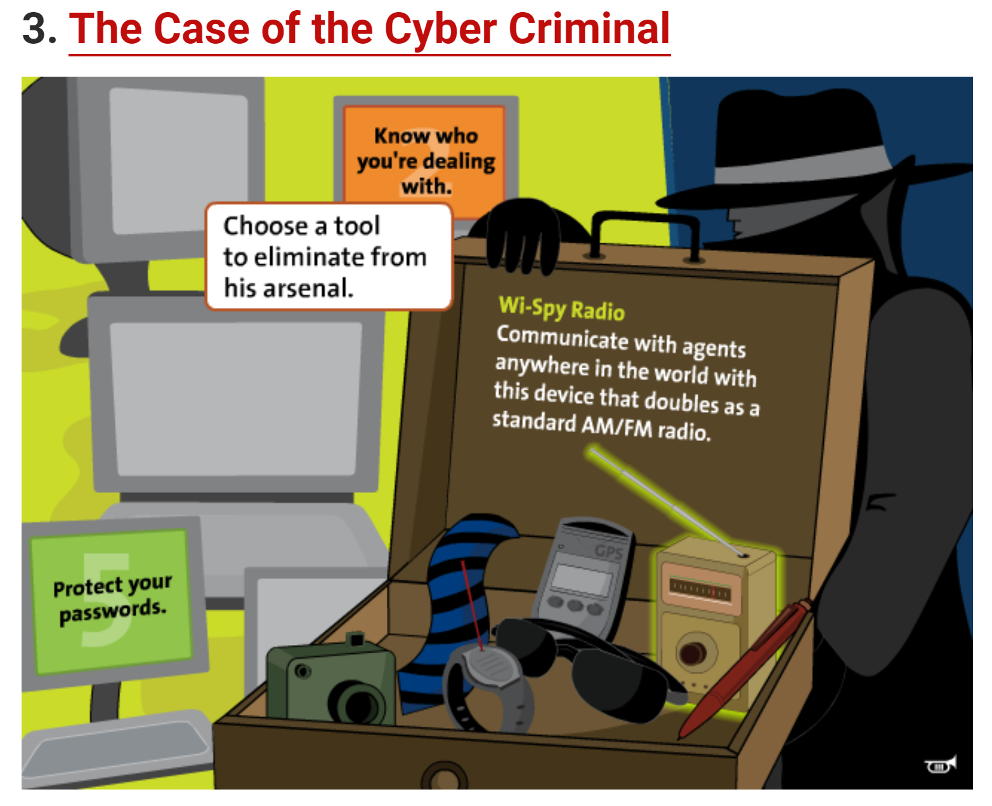
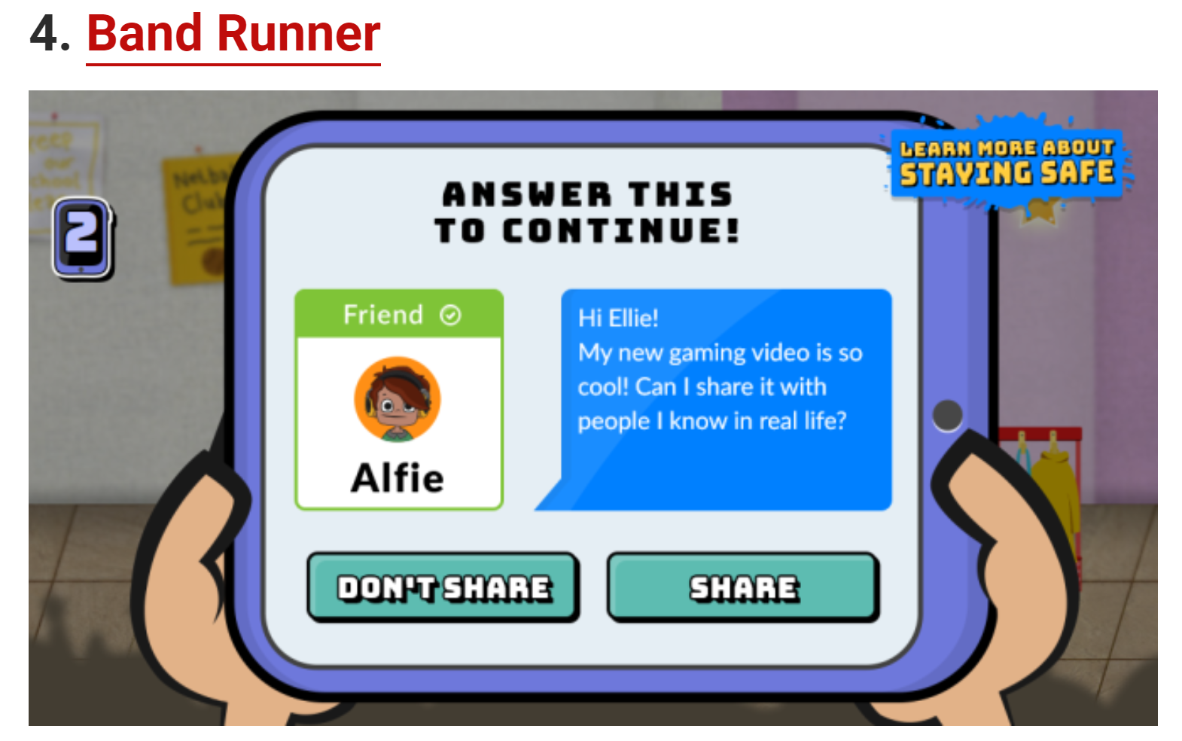
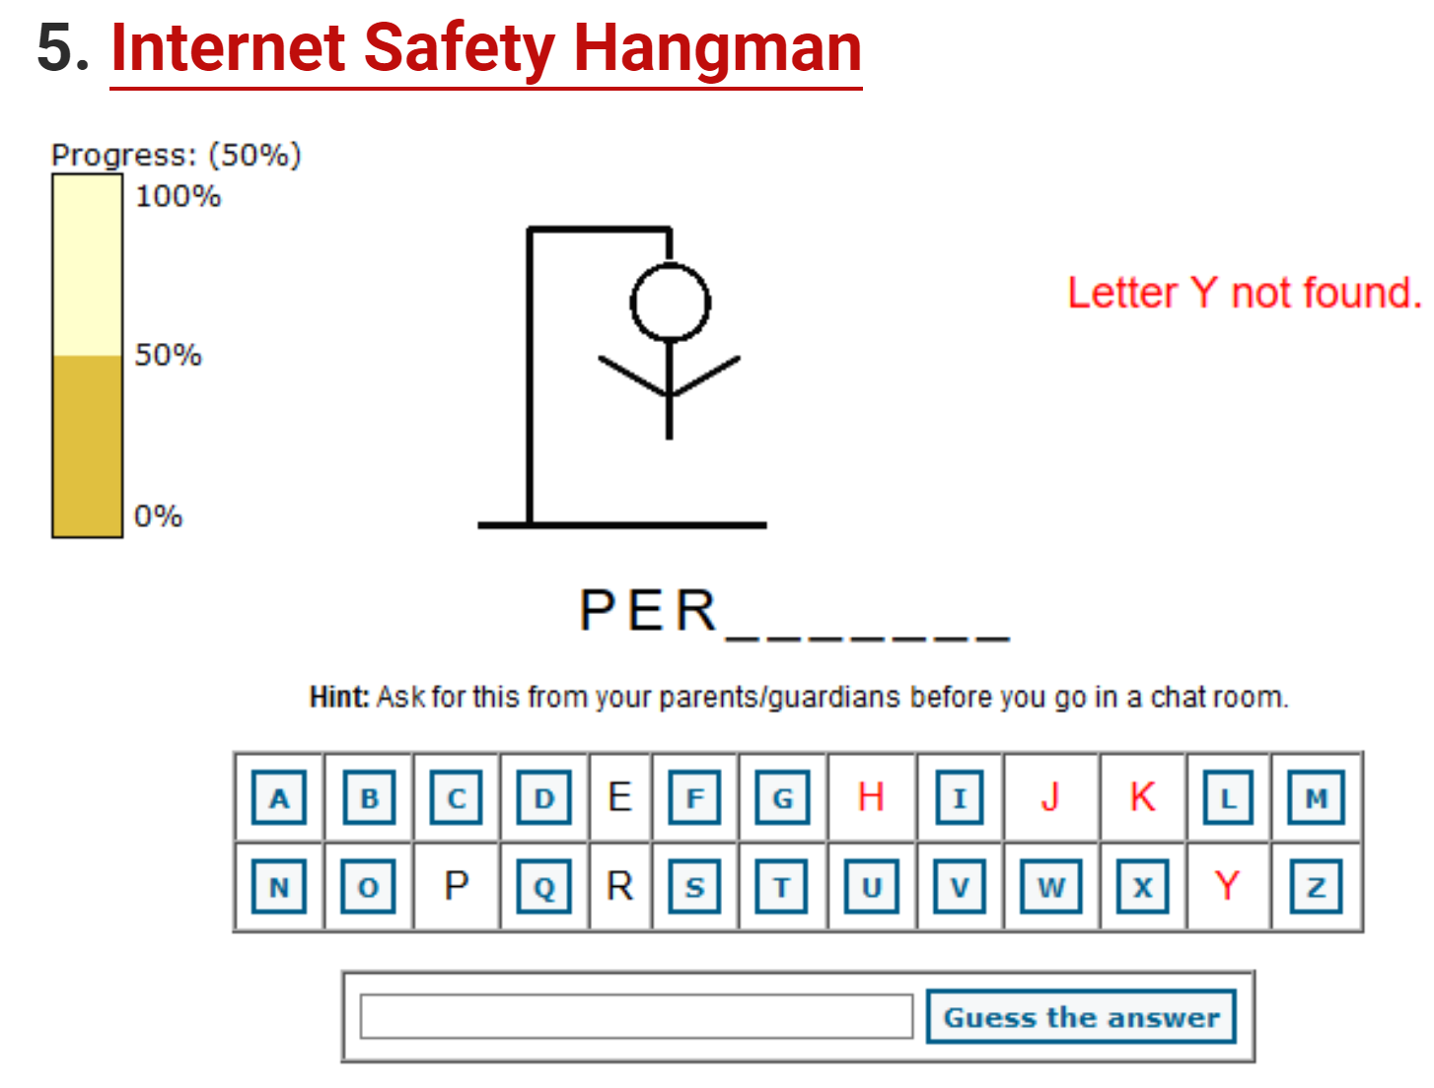
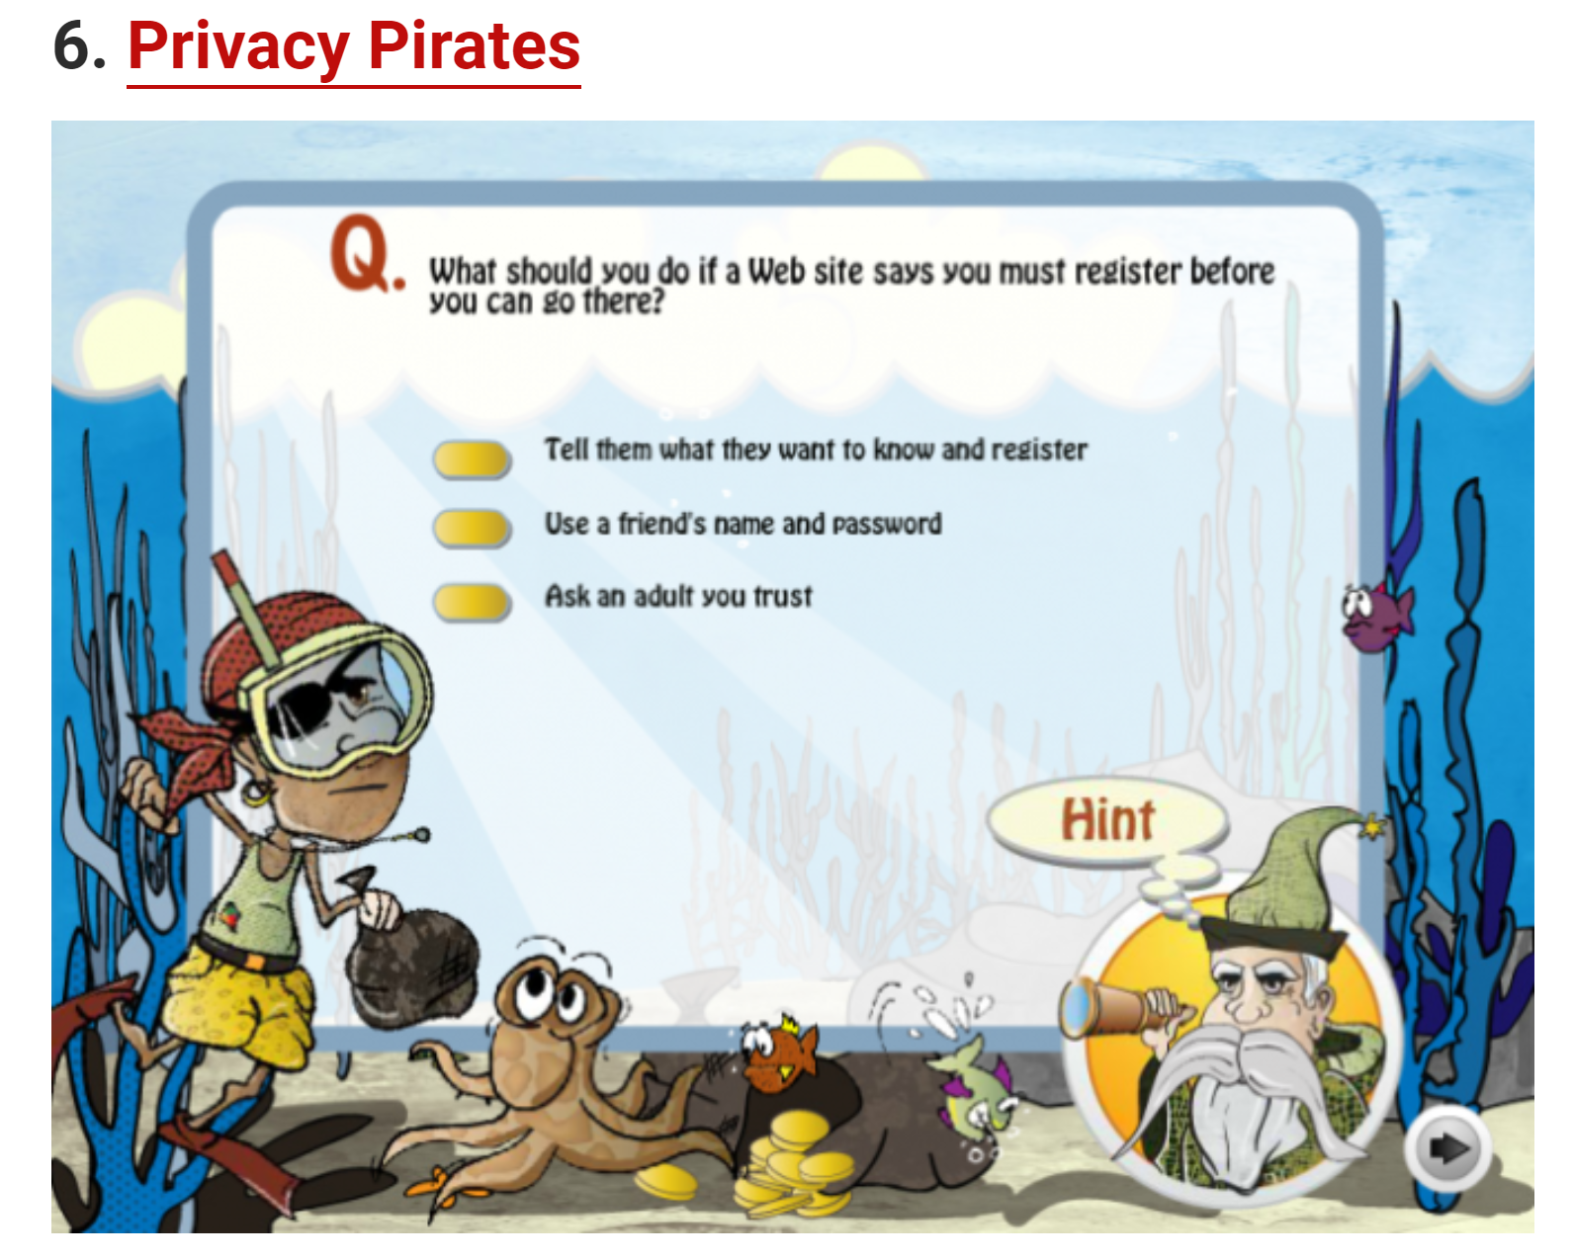
Internet Safety Games (pG.23) Choose one of the following games to learn about internet safety https://www.makeuseof.com/tag/6-internet-safety-games-kids-cyber-smart/
Notes:
ADDITIONAL / OPTIONAL
https://www.makeuseof.com/tag/6-internet-safety-games-kids-cyber-smart/

Slide 40
EXIT TICKET:
Have a quick chat with your friend about the statement below:
“3 things I can do to stay safe online are…”
Share your 3 things with your teacher as you leave the class.

